Slide 1

PCWG Intelligence Sharing Initiative
8 September 2016
Pamplona, Spain

Slide 2
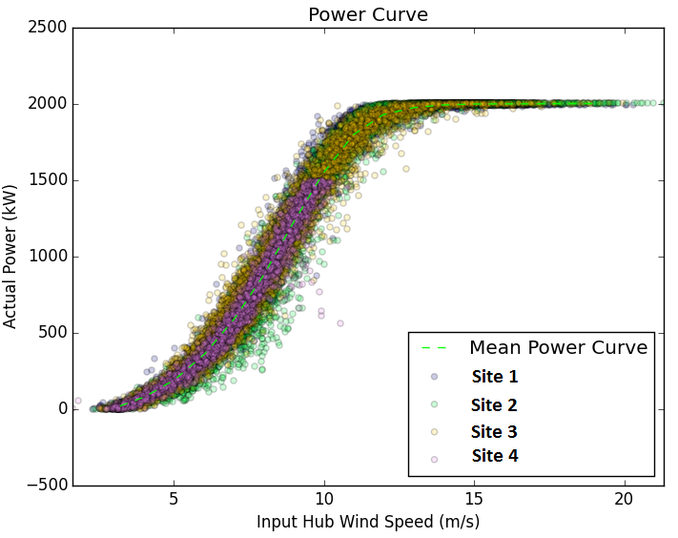
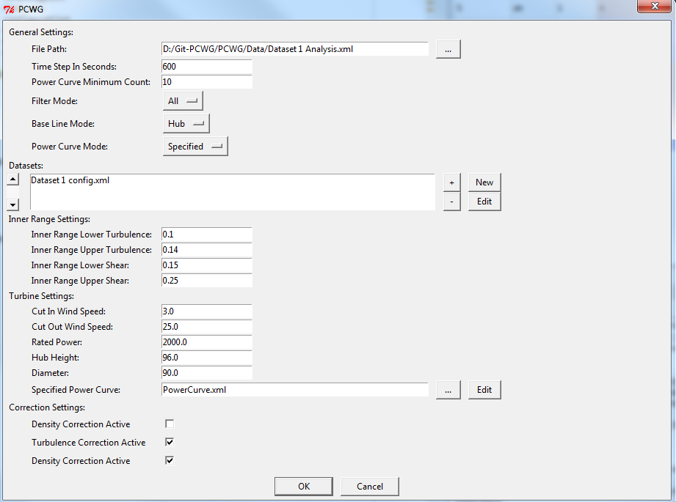
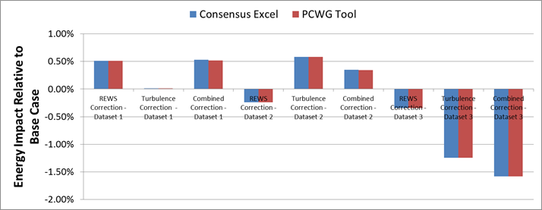
PCWG-Share-01: PCWG Analysis Tool
PCWG-Share-01: Enabled by PCWG Analysis Tool.
Consistent data analysis and anonymous report generation.
‘Just do it’ PCWG-Share-01 button (minimise set-up time)
Excel Benchmark and PCWG Analysis Tool Comparison

Slide 3
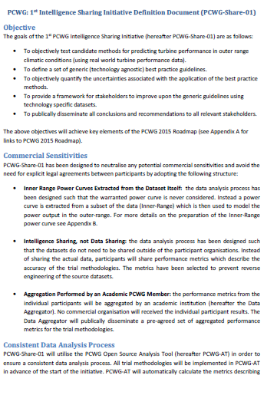
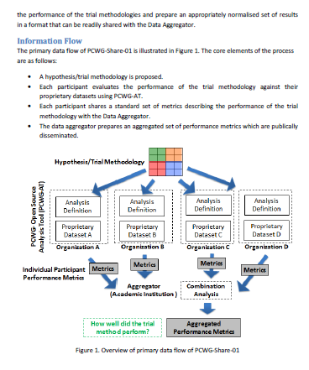
PCWG-Share-01 Definition Document
Download PCWG-Share-01 Definition Doc from www.pcwg.prg

Slide 4
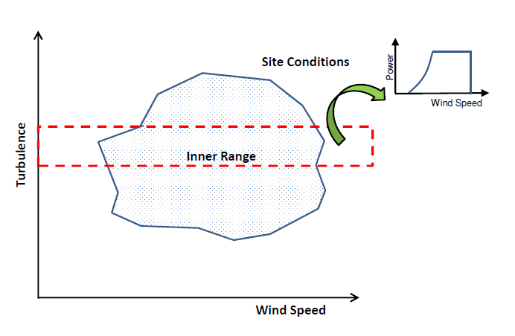
PCWG-Share-01: Neutralising Commercial Sensitivities
Inner Range Power Curves Extracted from the Dataset Itself: the data analysis process has been designed such that the warranted power curve is never considered. Instead a power curve is extracted from a subset of the data (Inner-Range) which is then used to model the power output in the outer-range.
Intelligence Sharing, not Data Sharing: the data analysis process has been designed such that the datasets do not need to be shared outside of the participant organisations. Instead of sharing the actual data, participants will share performance metrics which describe the accuracy of the trial methodologies.

Slide 5
PCWG-Share-01: Data Flow
Hypothesis/Trial Methodology
Analysis Definition Y
Analysis Definition Y
Analysis Definition Y
Analysis Definition Y
Proprietary Dataset A
Proprietary Dataset B
Proprietary Dataset C
Proprietary Dataset D
Organization A
Organization B
Organization C
Organization D
Hypothesis Performance Metrics
Aggregator
(Academic Institution )
Combination Analysis
How well did the trial method perform?
Aggregated Hypothesis Performance Metrics

Slide 6
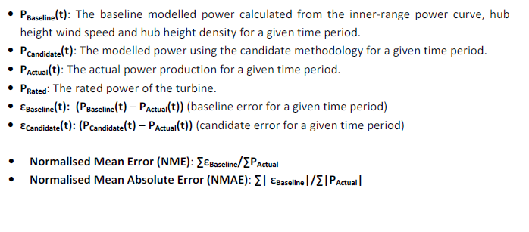
PCWG-Share-01: Error Metric Definitions
See PCWG-Share-01 Definition Document for Further Details

Slide 7
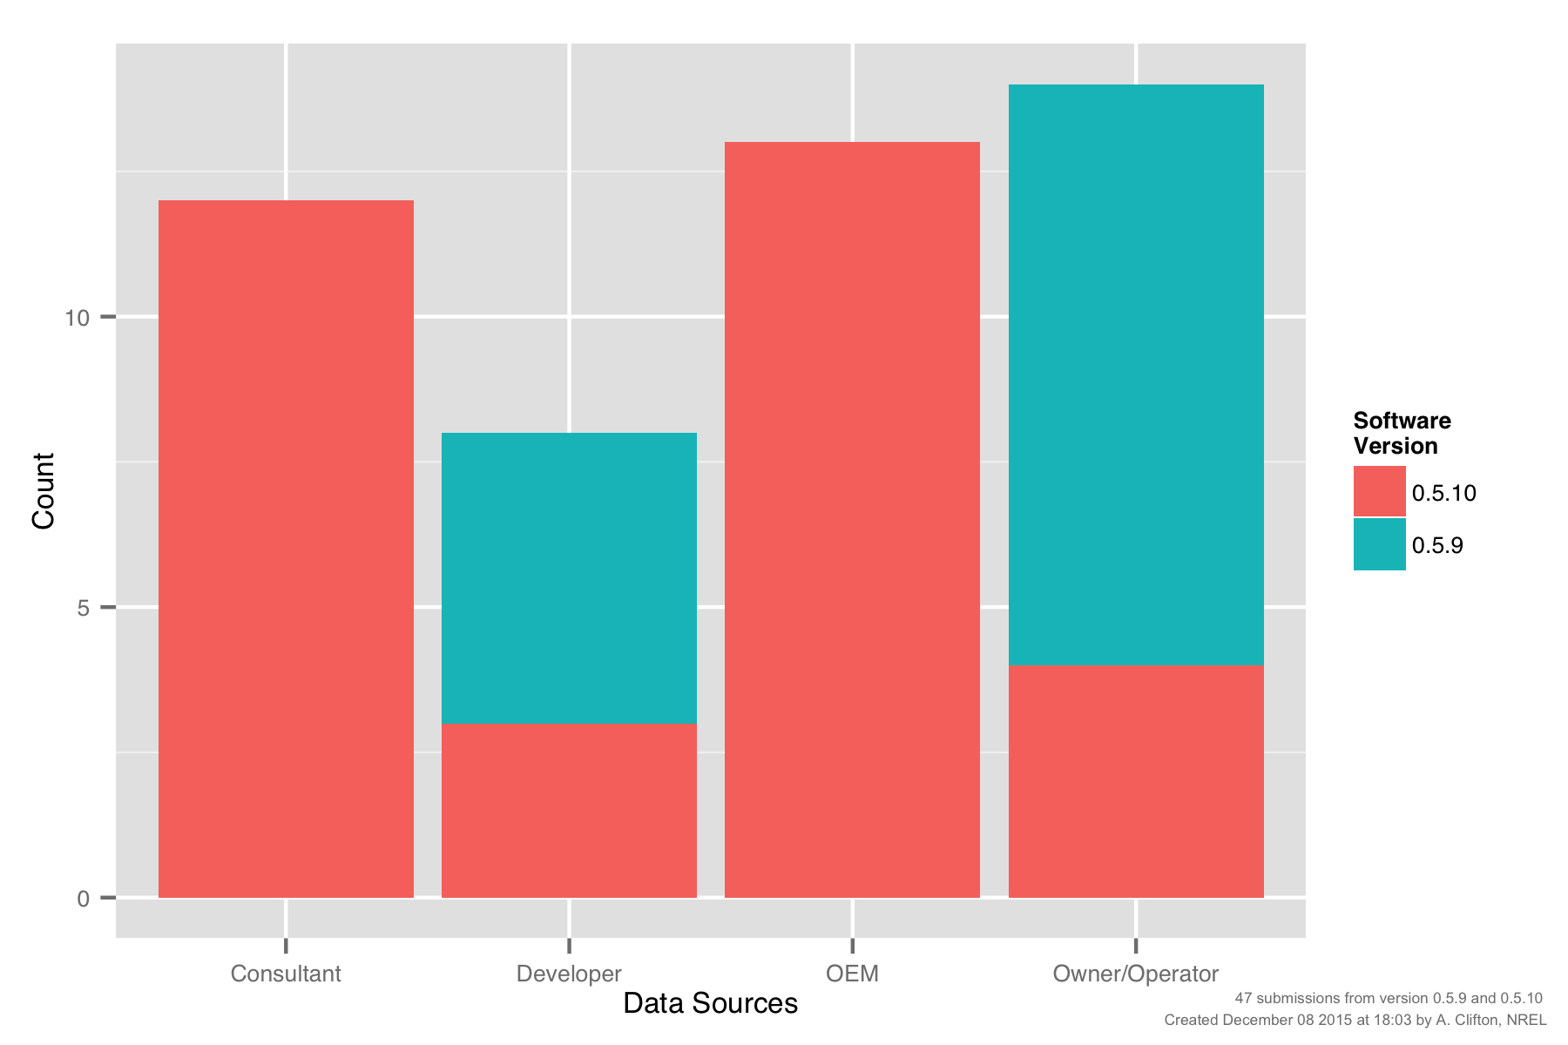
PCWG-Share-01: Submissions by Participant Type

Slide 8
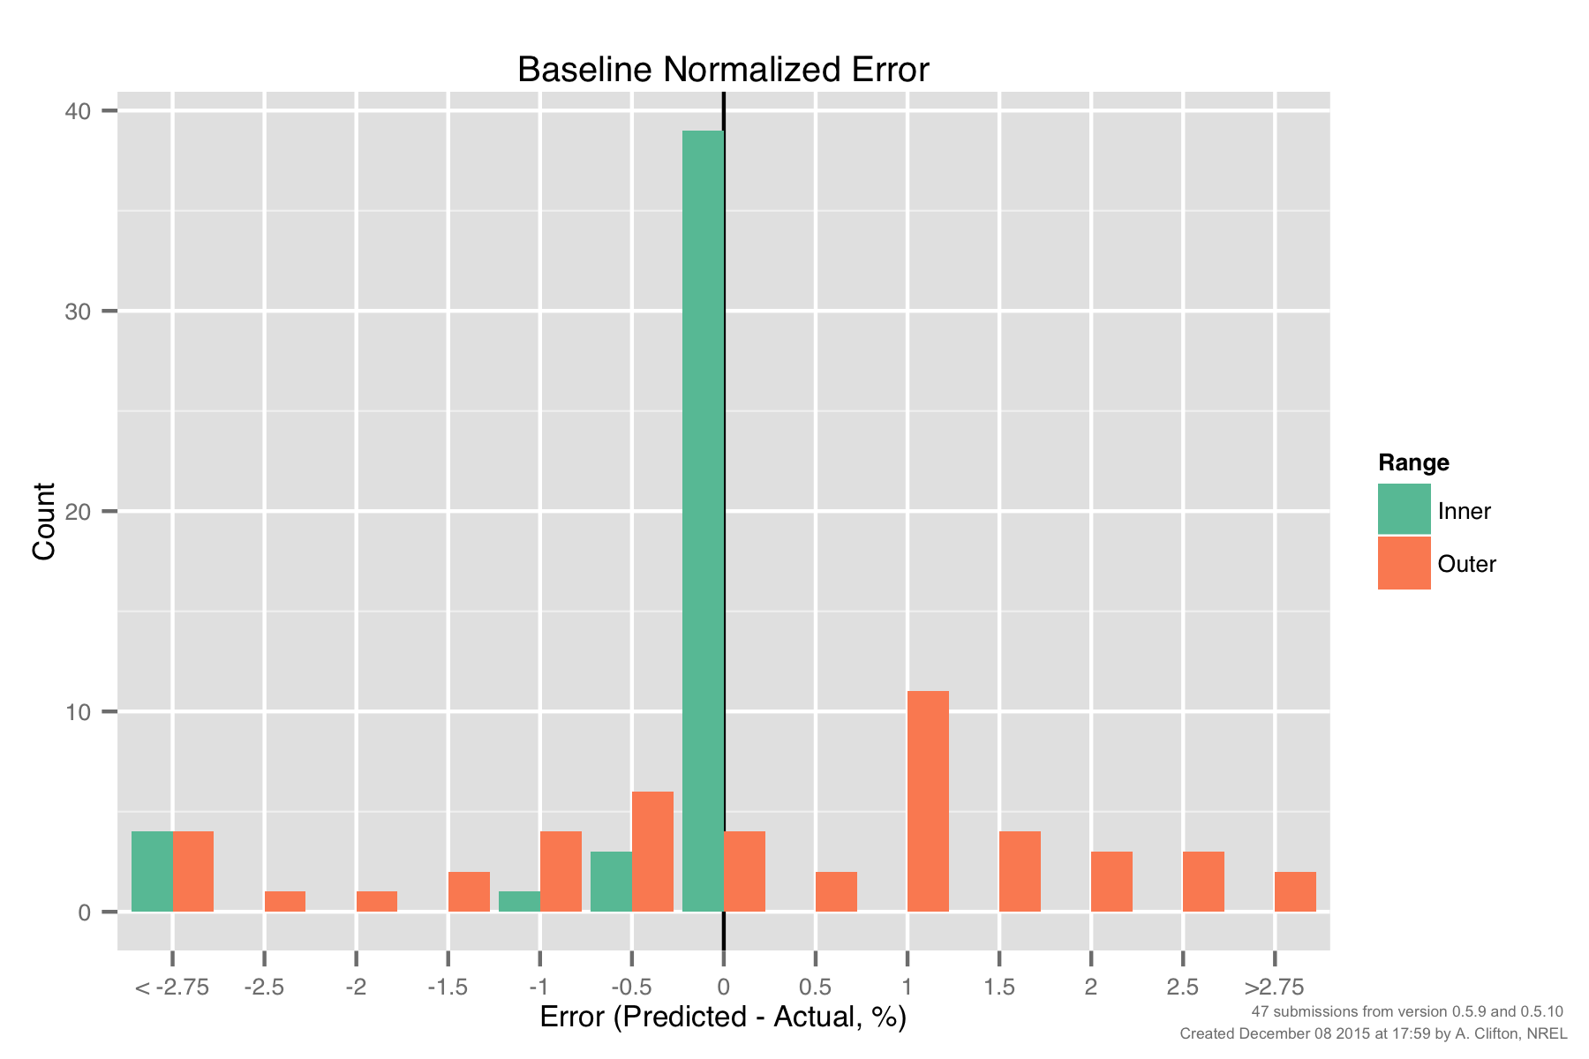
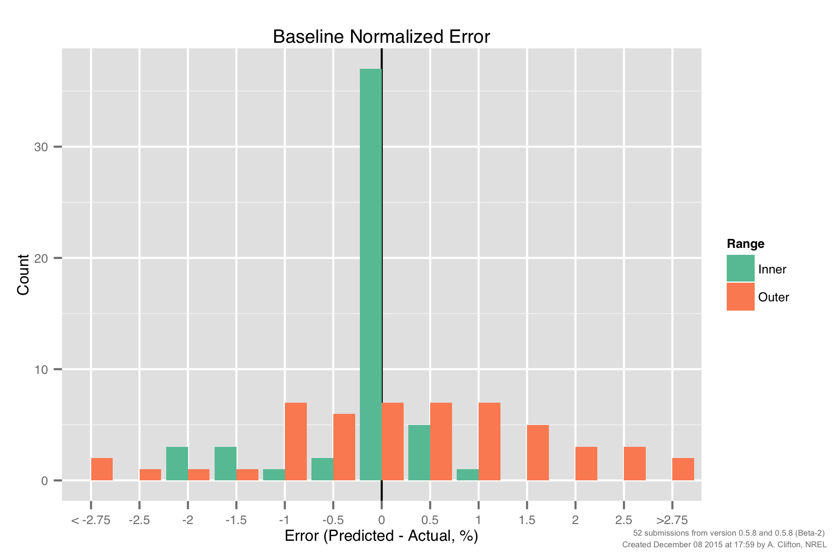
PCWG-Share-01: Baseline Error, Inner vs Outer Range
Version 0.5.9/10
Still unexpectedly large errors for baseline inner range
(further investigation required)
Smaller inner baseline errors still warrant further investigation
‘Uncertainty’ associated with
‘Outer Range’ effects.
Std Dev ≈ 2%

Slide 9
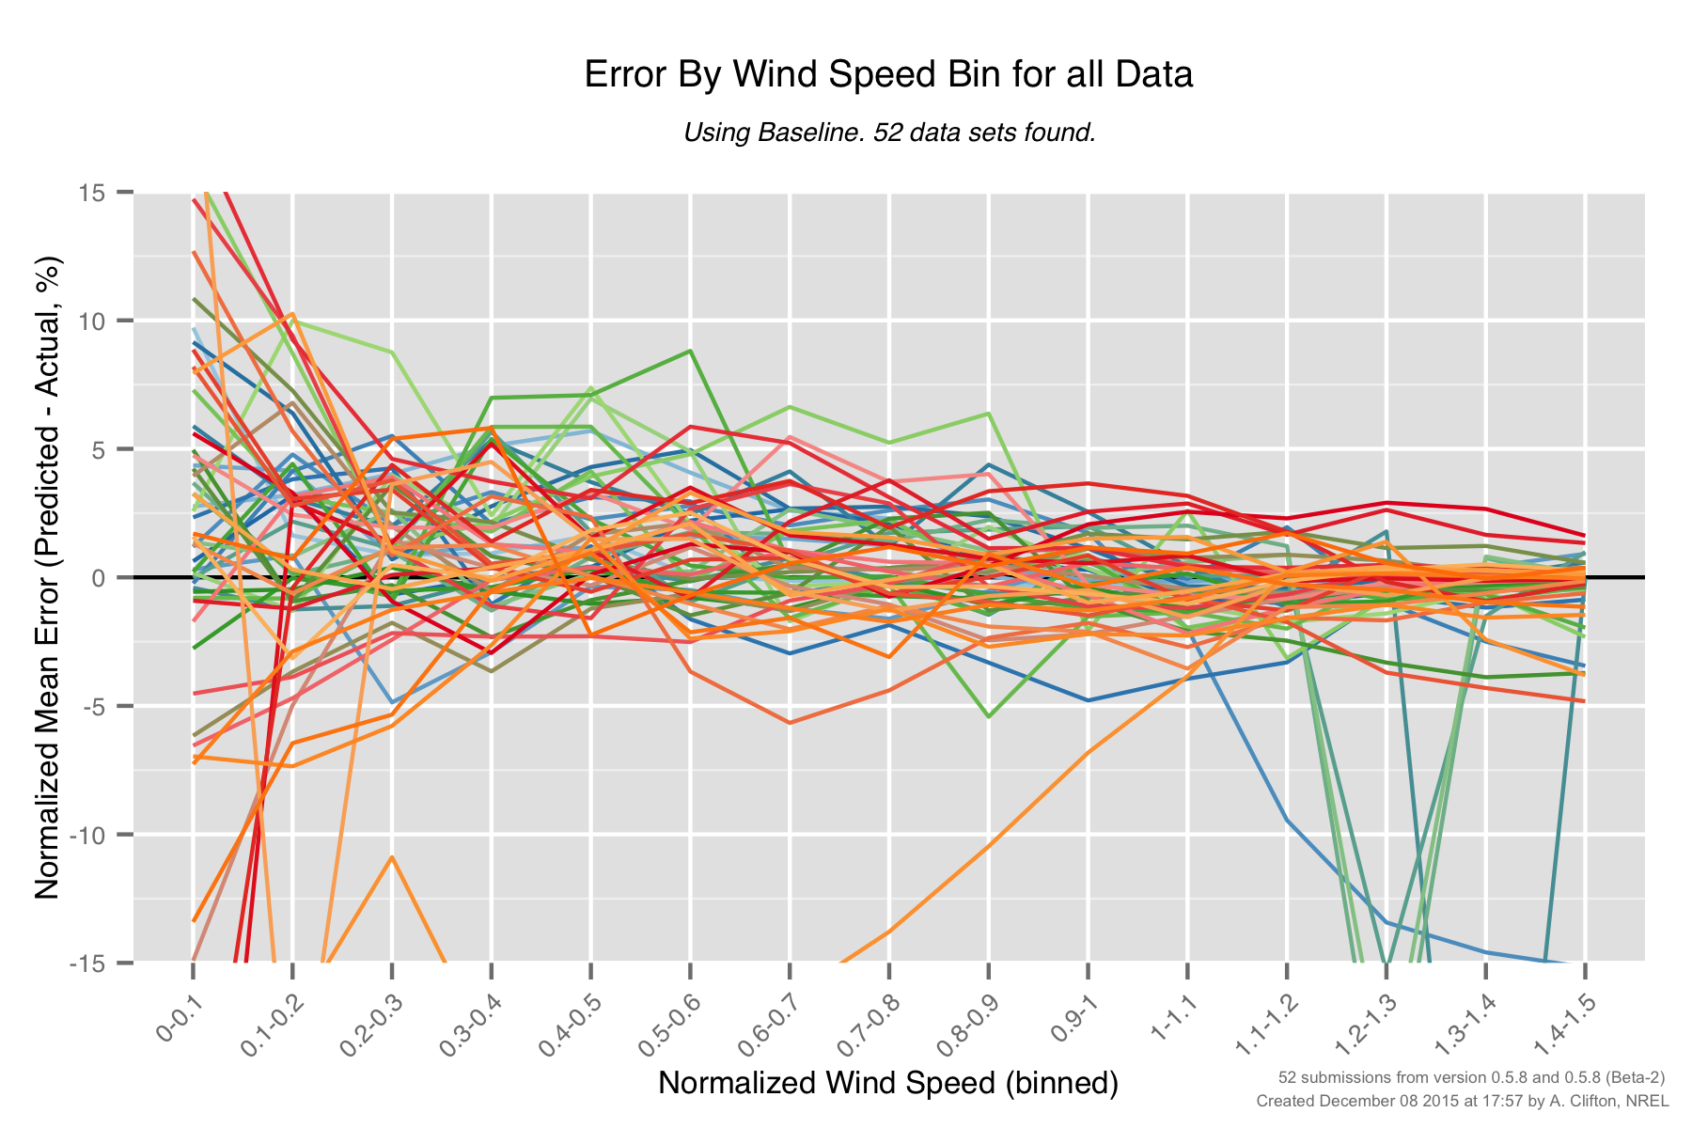
PCWG-Share-01: Baseline Errors by Wind Speed (0.5.8)
Large errors above rated for certain datasets.

Slide 10
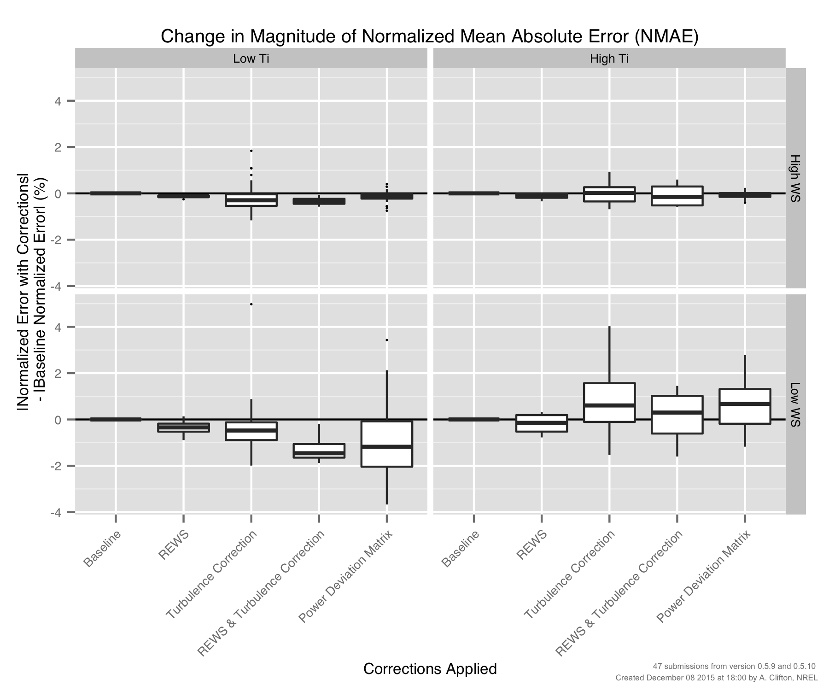
PCWG-Share-01: Errors by Method (‘Four Cell Matrix’)

Slide 11
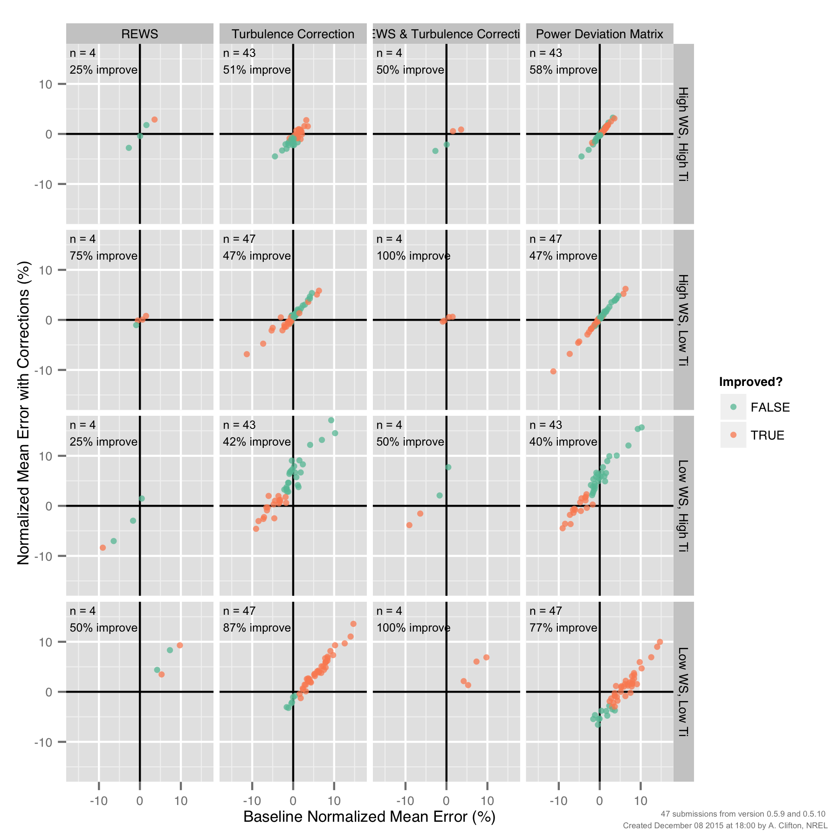
PCWG-Share-01: Improvements by Method (‘Four Cell Matrix’)

Slide 12
Erroneous Outlier Issue

Slide 13
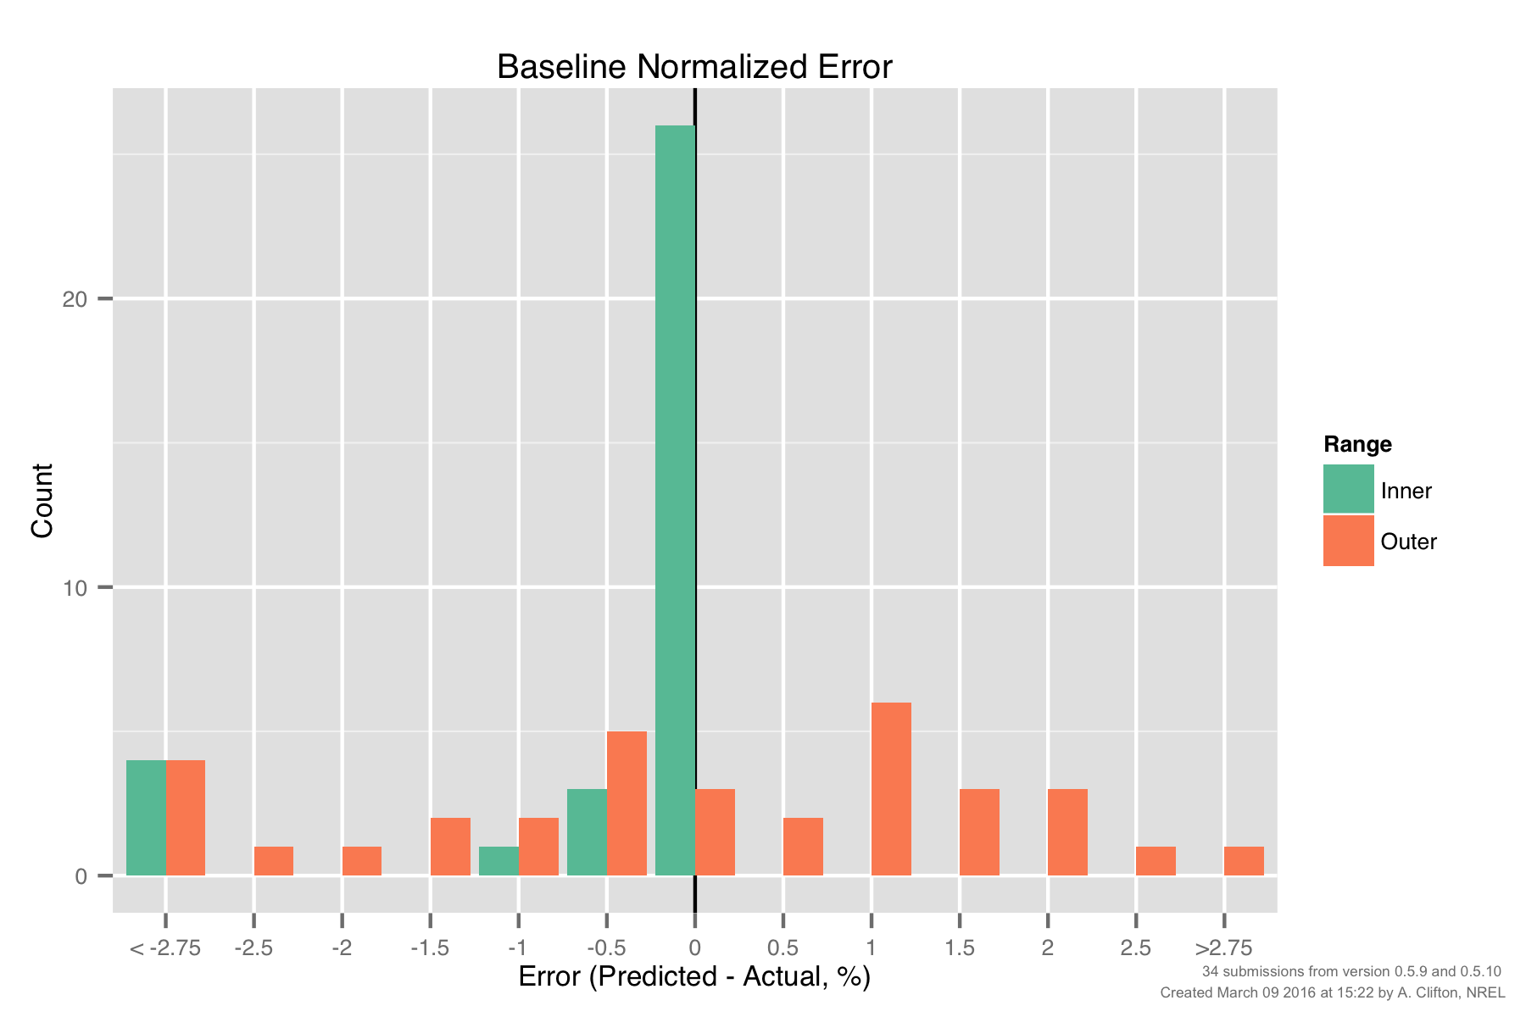
PCWG-Share-01: Baseline Histogram for ‘Follow Up’ Datasets
PCWG participants were asked for permissions to allow the data aggregator to investigate their submissions for sources of error.
Owners of 34 datasets responded positivity. A baseline NME histogram for these participants is shown below.

Slide 14
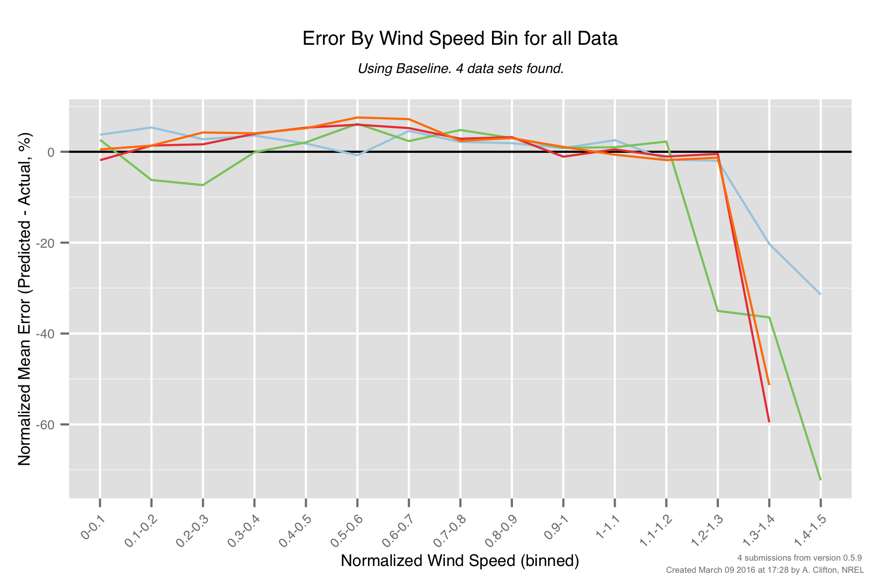
PCWG-Share-01: Baseline Errors by Wind Speed (Outliers Only)
The 4 large negative NME outliers all have a distinct ‘by wind speed error signature’.
Further investigation is required to ascertain what is going on with these datasets.
Large errors at high wind speeds

Slide 15
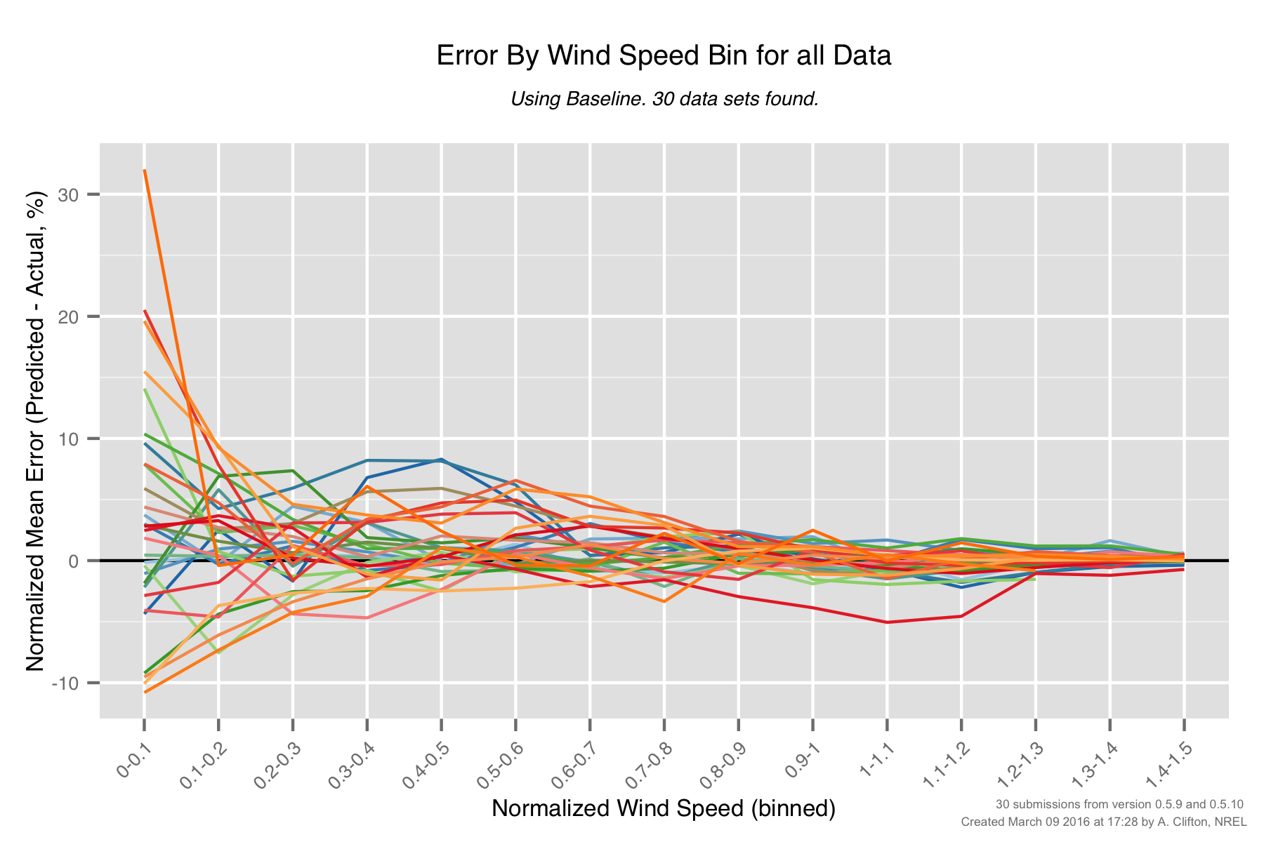
PCWG-Share-01: Baseline Errors by Wind Speed (Non-outliers)
The ‘by wind speed’ errors of the non-outliers look more reasonable, although some notable behaviour is observed (as highlighted).
Re-plot once interpolation issue is resolved.
Interpolation Issue
Notable behaviour for ‘blue’ dataset.
Notable behaviour for ‘red’ dataset.

Slide 16
PCWG Analysis Tool Release 0.6.0
Release 0.6.0 marks a major step forward for the PCWG Analysis Tool (PCWG-AT). This release implements several points of feedback raised by PCWG members during 2015-2016, specifically:
Usability: Several changes have been made to make PCWG-AT easier to use.
Turbine parameters moved: Following user feedback the turbine parameters (cut-in speed, cut-out speed, rated power, diameter and hub height) have been moved from the Analysis to the Dataset. This change acknowledges that these turbine parameters are inherently tied to dataset and will not charge according to what analysis is performed. This change has also helped simplify the implementation of the dataset portfolio feature (see below).
Faster and easier PCWG-Share-X participation: A new dataset portfolio feature has been introduced to reduce the time and effort required to participate in PCWG-Share-X. After initial set up participation should now take ‘one click’.
Enhanced Relative File Path Support: The handling of relative file paths within PCWG-AT has been made more robust.
Additionally there has been a substantial overhaul of the PCWG-AT source code structure, specifically the separation of the code into several component libraries. This reorganisation has helped increase the maintainability of the code and will hopefully lead to faster development and issue resolution in the future.

Slide 17
Many thanks to all PCWG-Share-01 Participants and special thanks to
Andy Clifton of NREL
Join the Power Curve Working Group at: www.pcwg.org

